Slide 1

TOXIC COMMENT DETECTION USING DEEP LEARNING ALGORITHM
by Aditi ShrIVASTAVA

Slide 2

Objective
Despite the public arena that the internet offers for anybody to debate anything, abuse and harassment are keeping people from sharing their thoughts and disturbing the online community.
Our goal is to create deep learning models which can identify toxicity in online interactions—which is characterized as anything unpleasant and disrespectful—because of this problem.

Slide 3

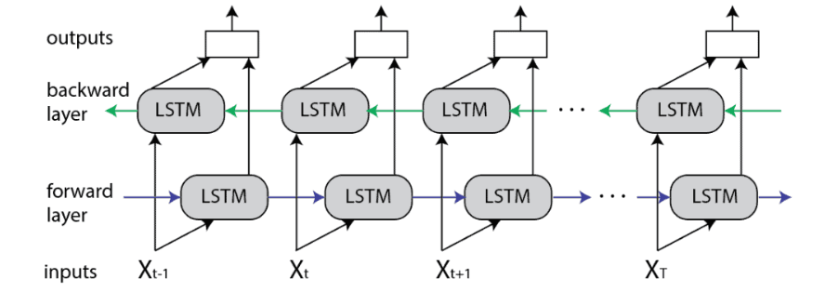
Bi-LTSM
"Bi-LTSM" is another name for a bidirectional Long Short-Term Memory (LSTM) neural network.
LSTM networks are a particular kind of RNN that can learn long-term dependencies.
The word "bidirectional“ means the network can perform both forward and backward processing of the input data.
With the help of this approach, the neural network can gather data from both historical and prospective contexts

Slide 4

DataSet
The training set consists of about 160K data points that have been categorized into a table with the following columns: identity_hate, toxic, severe_toxic, obscene, threat, and insult.
If every column is zero, the statement is deemed non-toxic; if not, the statement is deemed to fit best in one column.

Slide 5
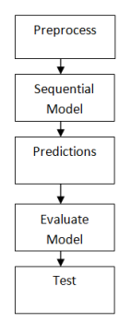
FlowChart
Preprocessing: In this stage the dataset divides comments into six categories
Sequential Model: The model created Bi-LTSM, and embedding
Prediction and Evaluation: Using a specially created interface, the score_comment technique is used to provide forecasts for the comments that users have entered. The interface will display the forecasts as text.
Testing: The score_comment function is used to provide estimates for the comments that users have entered. On the user experience, the forecasts will be displayed as text.

Slide 6

Sequential Model Flow
Input Sequence
The input sequence is a collection of information points, like words in a phrase or symbols in a text. Single data points are often represented using vector or embedding representations.
Embedding:
Dense representations of vectors called embeddings are produced by often altering the input sequence. Embeddings not only provide a more succinct and meaningful representation for the subsequent layers, but they also capture the semantic meaning of every individual piece of information..
Bi-LSTM:
The two LSTM layers that make up this structure process the input sequence forwards in the first layer and backward in the second. An LSTM contains a distinct set of parameters for each layer.

Slide 7
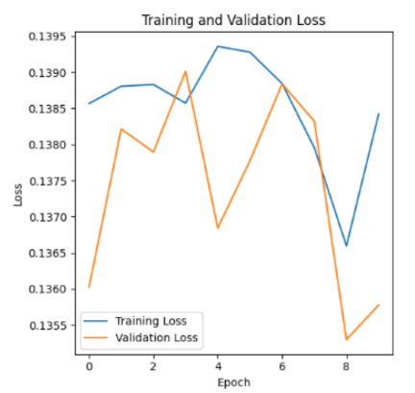
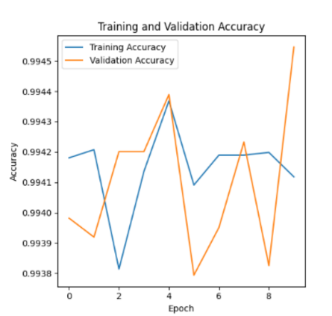
Results
By considering both past and future data, Bi-LSTM can capture richer interdependencies in the input sequence.
For the validation and training sets, the accuracy achieved with the Embedding with Bi-LSTM sequential model is almost 99%, with a loss of about 0.13.

Slide 8
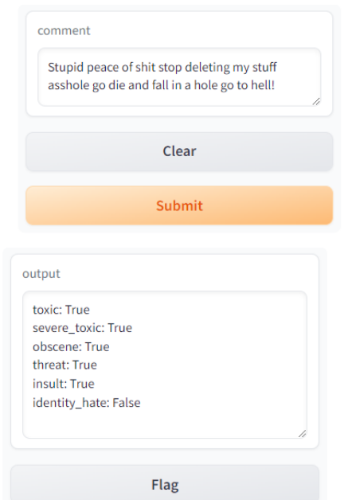
GUI
Gradio library is used to design the GUI
This GUI could tell if the comment is toxic or not based on the input comment provided.
There are two parts : one which takes the input and other which tells in which category does the comment falls under

Slide 9
THANK YOU

